Slide 1
INSURANCE FORECAST
Vaishali Yadav (21)
Ruhi Gupta (09)
Amey Mohite (14)

Slide 2
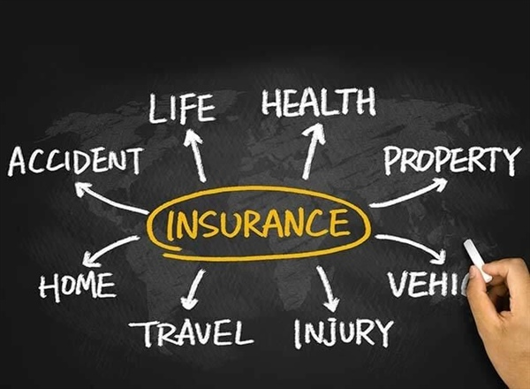
WHAT IS INSURANCE ?
Insurance is a means of protection from financial loss. It is a form of risk management, primarily used to hedge against the risk of a contingent or uncertain loss.

Slide 3
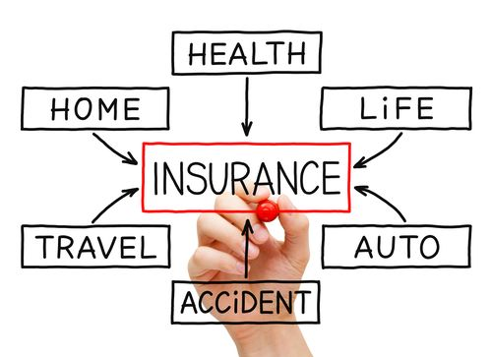
TYPES OF INSURANCE

Slide 4
The insurance claim process varies somewhat depending on the type of insurance you’re dealing with.
For starters, you should examine your insurance policy so that you understand your rights and responsibilities, including:
Whether or not your policy covers the situation you’re dealing with
Applicable timelines for filing a claim (some instruct you to file a claim within 24 hours of the relevant incident)
Whether you have multiple types of policies that could cover the same thing (for example, an umbrella policy provides coverage in addition to certain existing policies)
If you have any deductibles that could apply to your situation (if the amount of your claim is less than your deductible, it may not be worth pursuing a claim which could raise your insurance rates)

Slide 5
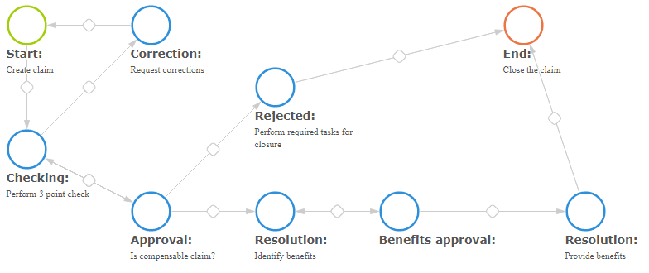

Slide 6
PROBLEM STATEMENT

Slide 7
INFORMATION ABOUT DATASET
Variable | Definition
Age | Age of policyholder
Sex | Gender of policy holder
BMI | Body mass index, providing an understanding of body, weights that are relatively high or low relative to height, objective index of body weight (kg / m ^ 2) using the ratio of height to weight, ideally 18.5 to 25
Steps | Average walking steps per day of policyholder

Slide 8
Variable | Definition
Children | Number of children / dependents of policyholder
Smoker | Smoking state of policyholder
Region | The residential area of policyholder in the US
Charges | Individual medical costs billed by health insurance
Insurance Claim | Insurer will claim the insurance or not

Slide 9
Independent Variables | Age, Sex, BMI, Steps, Children, Smoker, Region, Charges
Dependent Variable(Predicting) | Insurance Claim

Slide 10
DATA PREPARATION
Variable | Encoding
Sex | Female=0 Male=1
Smoker | Non-smoke=0 Smoker=1
Region | Northeast=0 Northwest=1 Southeast=2 Southwest=3
Insurance Claim | No=0 Yes=1

Slide 11
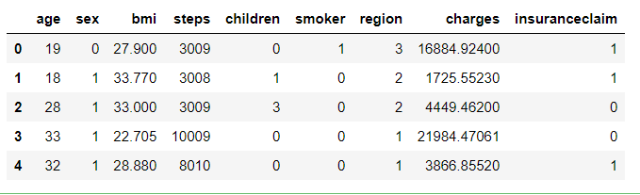
DATA EXPLORATION

Slide 12
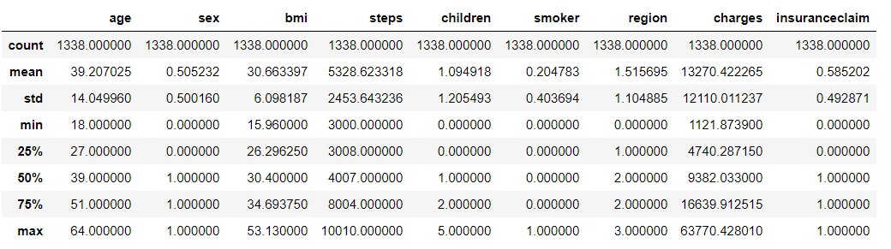
DATA SUMMARY

Slide 13
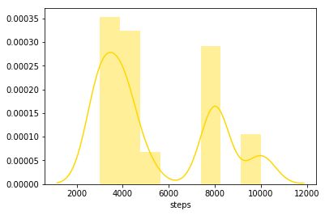
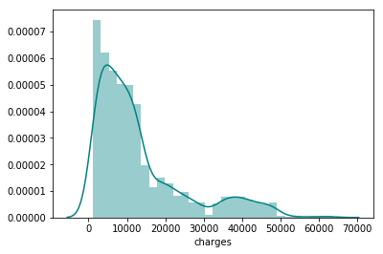
Univariate Analysis
Histograms

Slide 14
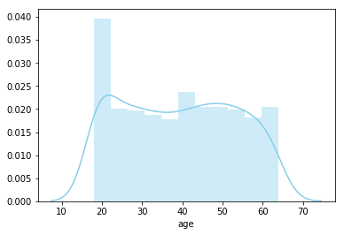
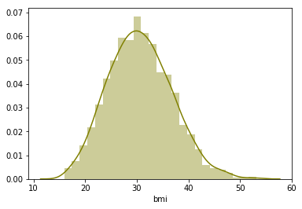

Slide 15
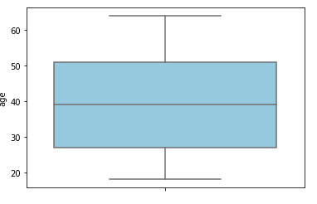
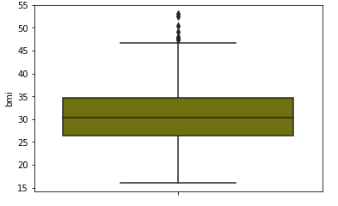
Boxplot For checking outliers

Slide 16
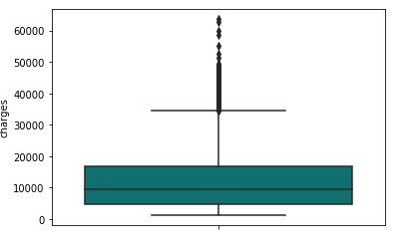
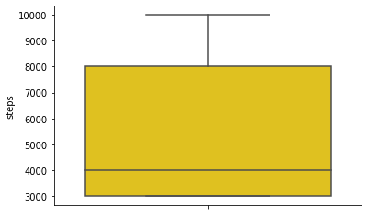

Slide 17
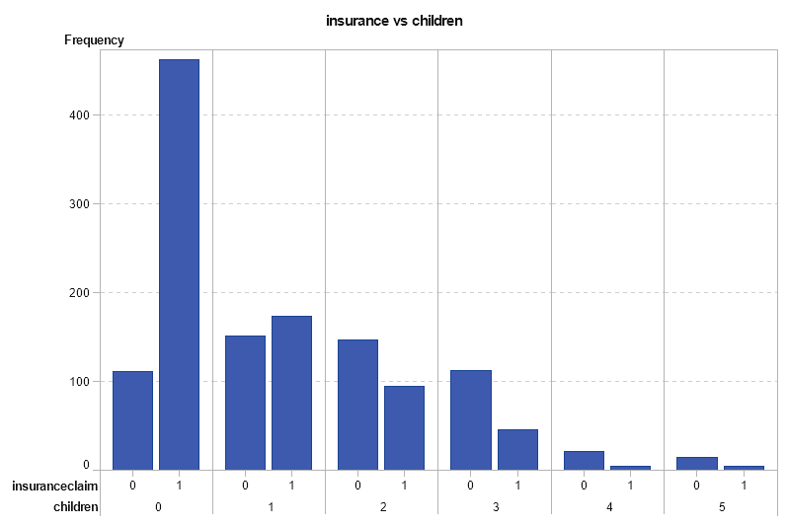
Bivariate Analysis

Slide 18
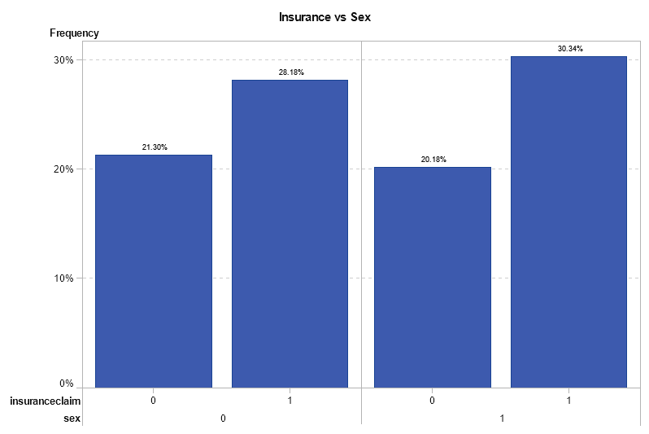
Bivariate Analysis

Slide 19
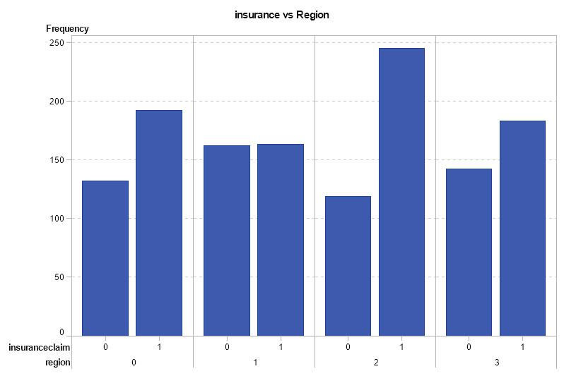

Slide 20
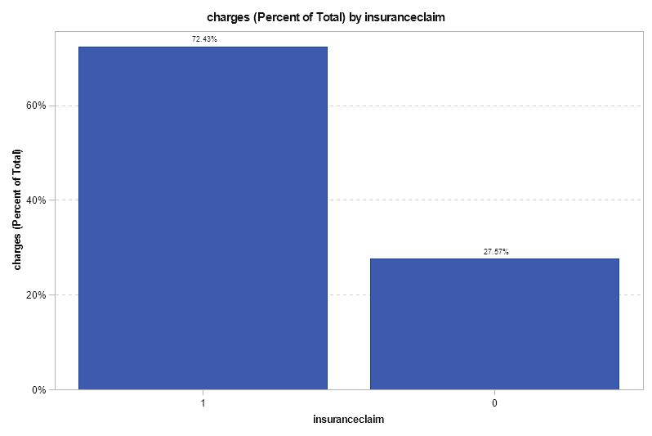

Slide 21
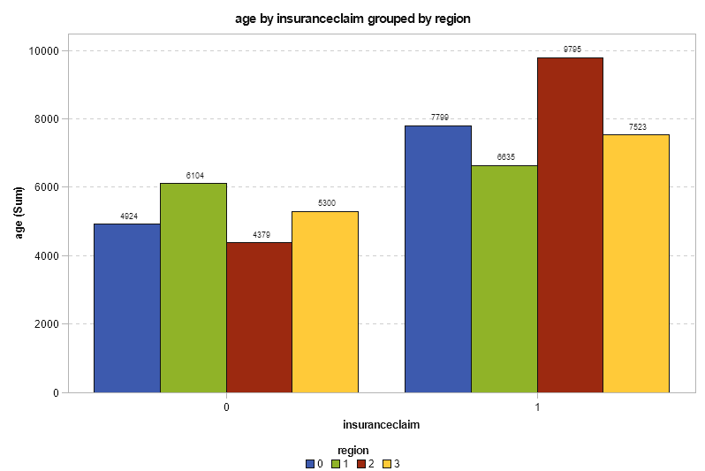

Slide 22
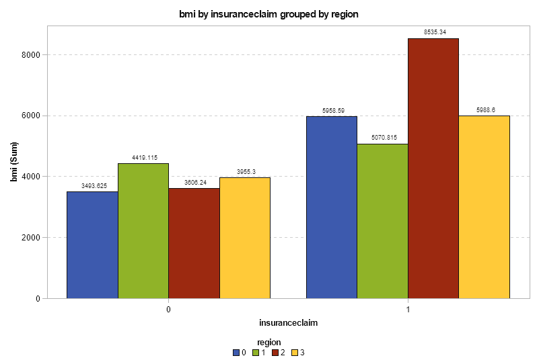

Slide 23
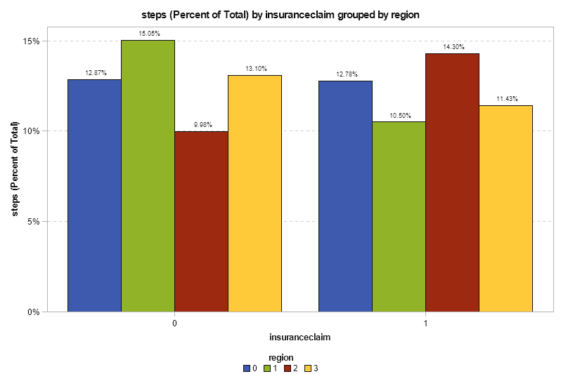

Slide 24
MODELS USED
Logistic Regression
K Nearest Neighbors
Decision Tree
Random Forest

Slide 25
MODELLING
-Considering all features

Slide 26
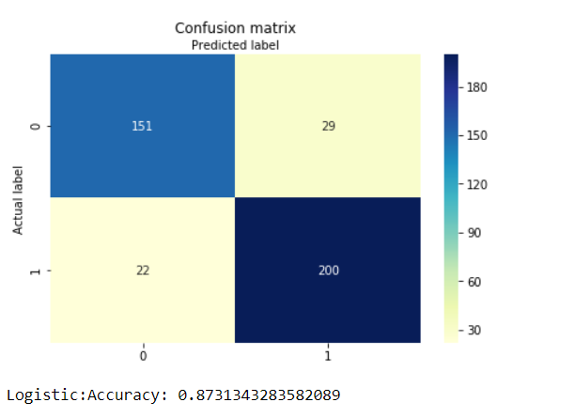
LOGISTIC REGRESSION
ACCURACY
TRAIN SET: 88.35 %
TEST SET: 87.83 %

Slide 27
KNN
ACCURACY
Train Set: 77.77 %
Test Set: 68.15 %

Slide 28
DECISION TREE
ACCURACY
Train Set: 84.61 %
Test Set: 85.57 %

Slide 29
RANDOM FOREST
ACCURACY
Train Set : 91.34 %
Test Set : 91.04 %

Slide 30
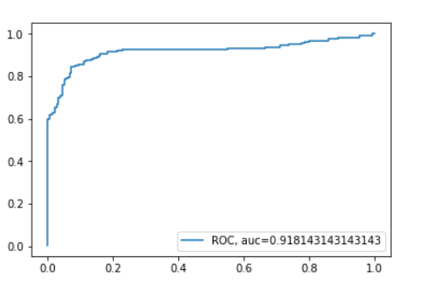

Slide 31
FEATURE SELECTION
Random Forest Classifier

Slide 32
MODELLING
Using Feature Selection
Age
BMI
Children
Smoker
Charges

Slide 33
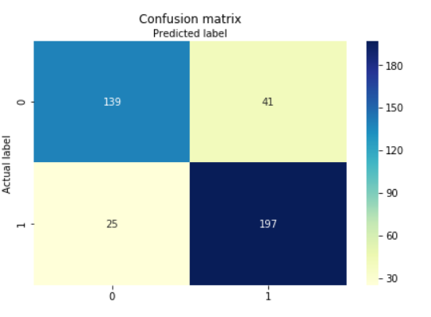
LOGISTIC REGRESSION
ACCURACY
TRAIN SET: 85.04 %
TEST SET: 83.58 %

Slide 34
KNN
ACCURACY
Train Set: 77.77 %
Test Set: 68.15 %

Slide 35
DECISION TREE
ACCURACY
Train Set: 84.61 %
Test Set: 85.57 %

Slide 36
RANDOM FOREST
ACCURACY
Train Set : 92.09 %
Test Set : 92.78 %

Slide 37
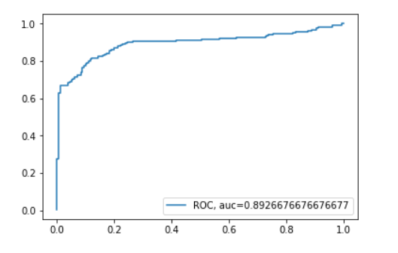
It tells how much model is capable of distinguishing between classes. Higher the AUC, better the model is at predicting 0s as 0s and 1s as 1s.

Slide 38
INTERPRETATION
1. no of steps should be more
2. Bmi should be, as per your height and weight
3. Southeast region has more number of claims
4. As age is increasing the insurance claims are paralleling increasing
5.People charged with higher claim amount …………….....aage kaa ..umm englsih sentence nahi ho rahaa hai

Slide 39
SOLUTION
1 . South region should have higher premium
2. Age is imp factor people who have age more (aisa kuch likh do :p) should have higher premium
3. Medical history should be check as bmi is imp factor…
4. People who are under daily exercise should be charged with low premium

